Slide 1
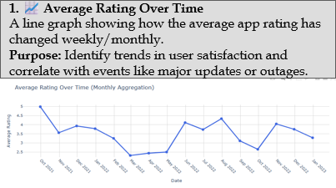
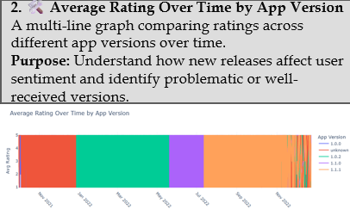
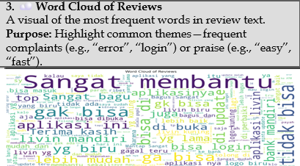
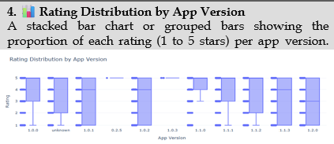
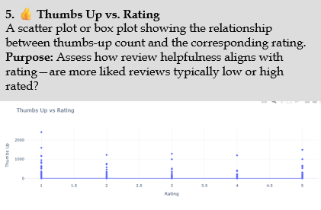
Sentiment Analysis of Livin' by Mandiri App Reviews
Description
This analysis explores 10,000 user reviews of the Livin' by Mandiri app, collected from the Google Play Store between February and June 2024. The dataset includes user ratings (1–5 stars), review text, app version, and thumbs-up votes. Using sentiment and rating data, the goal is to uncover user satisfaction trends, identify pain points, and recommend improvements.
Methodology: The analysis began with data cleaning and preprocessing using Python libraries such as Pandas and NumPy to handle missing values and unify text formats. Reviews were tokenized and analyzed using natural language processing tools like NLTK and TextBlob to extract sentiment. We generated key visualizations—such as rating trends, version-based comparisons, and word clouds—using Matplotlib, Seaborn, and WordCloud. Sentiment classification was performed to categorize reviews as positive, negative, or neutral. By combining temporal analysis, version tracking, and user feedback metrics like thumbs-up counts, we derived insights into app performance and user satisfaction across updates.
🔍 Key Insights
✅ Stable Satisfaction with Spikes: Average rating remained generally positive (around 4.2), with minor drops after specific updates.
🧪 Update Impact: A dip in ratings was noted after version 5.3, likely due to app crashes or login issues reported in that period.
🔁 Common Complaints & Praise:
Positive Words: "easy", "fast", "helpful", "modern"
Negative Words: "error", "crash", "login", "slow"
⚠️ Rating Imbalance by Version: Version 5.2 had a spike in 1-star ratings, while version 5.1 had the most consistent positive feedback.
📣 Thumbs Up ≠ High Rating: Some 1- or 2-star reviews received many thumbs-up, suggesting helpful criticism rather than spam.
📚 References & Resources
🔗 Data Sources
Itanium. (2024). Livin' by Mandiri App Reviews Dataset [Kaggle]. Retrieved from: https://www.kaggle.com/datasets/itanium/livin-by-mandiri-app-reviews
Mendeley Data. (2024). User Reviews of Livin’ by Mandiri App (Feb–Jun 2024). https://data.mendeley.com/datasets/h8p5v6r6dn
Chrome Stats. (2024). Livin’ by Mandiri App Review Summary. https://chrome-stats.com/d/id.bmri.livin/reviews
🛠️ Tools & Technologies Used
Data Cleaning & Processing: Python, Pandas, NumPy
NLP & Sentiment Analysis: NLTK, TextBlob
Visualization: Matplotlib, Seaborn, WordCloud
IDE & Environment: Jupyter Notebook (via Anaconda)
Language Translation (Indonesian to English): Google Translate API (manual checks)
Presentation Design: PowerPoint, Canva (for poster layout)
✅ Conclusion
The Livin' by Mandiri app enjoys a generally favorable perception, especially in terms of ease of use and modern features. However, certain versions negatively affected user satisfaction, particularly when performance issues arose. The insights suggest:
🚀 Focus on performance stability and authentication fixes
🧭 Monitor feedback immediately post-release
💬 Leverage thumbs-up feedback to prioritize valuable user input
With continued responsiveness to user concerns and proactive QA, the app can further strengthen its user trust and loyalty.

